Slide 1



Course: Data Mining
Bachelor Study Programme: Computer Science and Technology
Lesson 5:
Decision trees
Ass. prof. E. Pinevich

Slide 2
Learning Objectives
After studying this lesson, you will know:
The uncertainty of Gini.
After studying this lesson, you should be able to:
Explain «Divide and Conquer» algorithm.
Find the optimal condition for branching, using uncertainty of Gini.
Predict different results.
Present Decision trees.

Slide 3
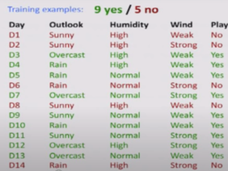
Predict if John will play tennis
There are observations for 14 days of various weather attributes and a target feature (playing tennis).
Let it rain on the 15th day, the humidity is high, it is not very windy.
It is necessary to determine whether John will play tennis under these conditions or not.

Slide 4
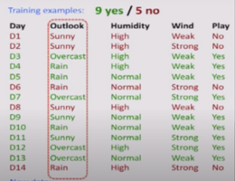
Predict if John will play tennis
Just looking at the data, it is quite difficult to do this, because sometimes he plays when it rains, sometimes he plays in a strong wind, and when there is a weak wind he does not play.
The main idea of using a tree is to understand under what conditions John is playing.
Decision trees try to evaluate each of these attributes (weather type, humidity, wind).
By attributes, we divide the data into subsets.
This is a kind of Divide-and-Conquer algorithm.
Try to understand when John plays.
Divide & Conquer: data split into subsets. Are they pure? (all yes or all no)
If yes: stop. If not: repeat.
See in which subset new data falls into.

Slide 5
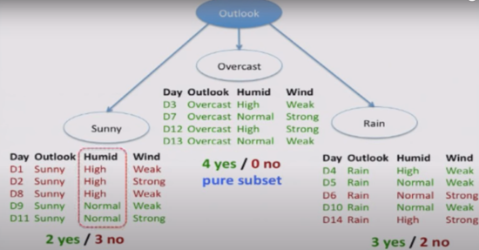
Divide and Conquer algorithm
The purpose of the division is to come to a pure subset: so that there are either only "Yes" or only "No“.
On the branch, all "Yes" are cloudy, so the division in this direction stops.
Next, select the humidity division in Sunny, and the wind division in Rain.

Slide 6
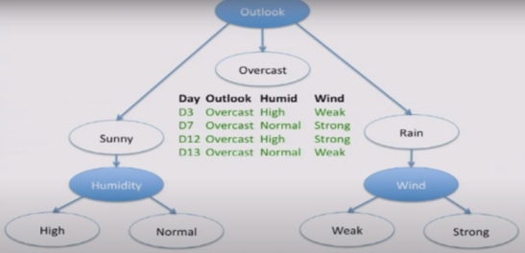
Day | Humidity | Wind | Play
D1 | High | Weak | No
D2 | High | Strong | No
D8 | High | Weak | No
Day | Humidity | Wind | Play
D6 | Normal | Strong | No
D14 | High | Strong | No
Day | Humidity | Wind | Play
D9 | Normal | Weak | Yes
D11 | Normal | Strong | Yes
Day | Humidity | Wind | Play
D4 | High | Weak | Yes
D5 | Normal | Weak | Yes
D10 | Normal | Weak | Yes

Slide 7
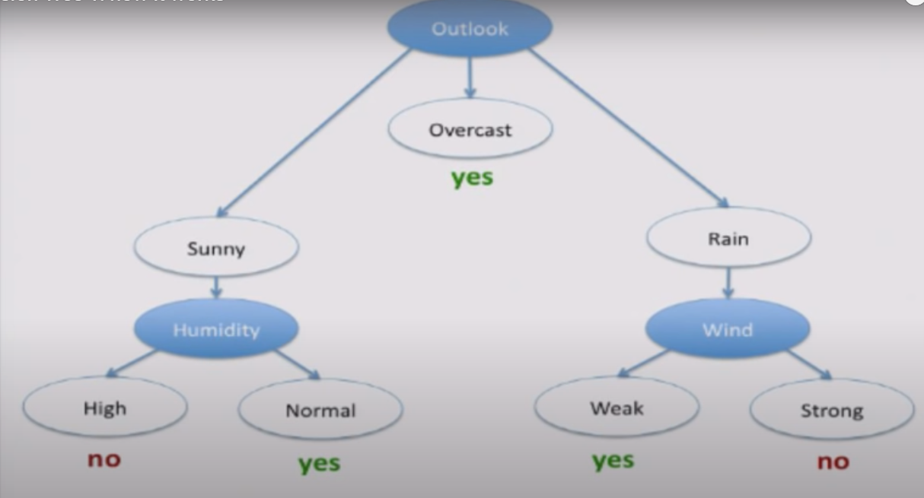
Logical predicate
We get a logical predicate, a formula by which we get in which cases John will play and in which cases he will not.
Therefore, on the D 15 the rain is strong or weak, the humidity is high, it is not very windy.
-> Yes.

Slide 8
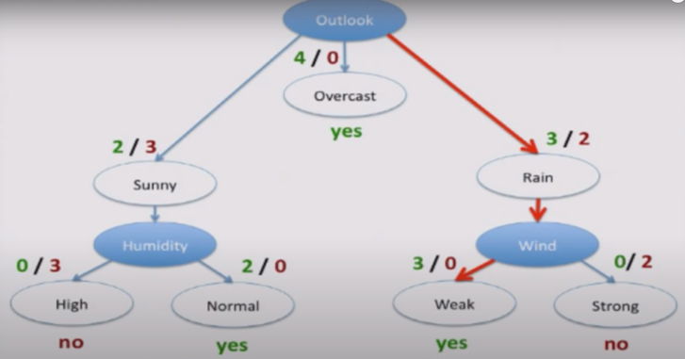
Learning Objectives
This allows you not only to make a forecast, but also to trust this forecast.

Slide 9
ISSUE 2: HOW TO FIND THE OPTIMAL FEATURE FOR BRANCHES ?
There are several criterias, each of which calculates its own value:
Entropy.
The uncertainty of Gini (we will study it in our course).
Statistical informativeness.
And so on…
For branching, there must be a numerical threshold in the tree, which determine on which branch to move on.
Notes:
For example, it is an architectural design issue whether a computer will have
a multiply instruction. It is an organizational issue whether that instruction will be
implemented by a special multiply unit or by a mechanism that makes repeated
use of the add unit of the system. The organizational decision may be based on the
anticipated frequency of use of the multiply instruction, the relative speed of the
two approaches, and the cost and physical size of a special multiply unit
Many computer manufacturers offer a family of computer models, all with the same architecture but with differences in organization.
In a class of computers called microcomputers, the relationship between
architecture and organization is very close. Changes in technology not only influence organization but also result in the introduction of more powerful and more
complex architectures. Generally, there is less of a requirement for generation to-generation compatibility for these smaller machines.

Slide 10
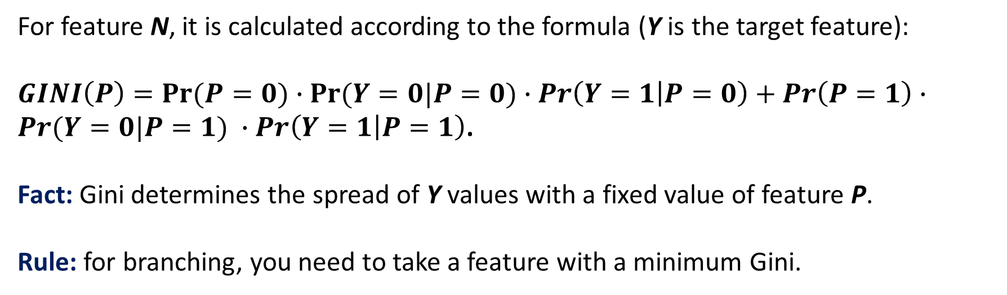
How to find the optimal condition for branching, using uncertainty of Gini?
Gini impurity
For feature N, it is calculated according to the formula (Y is the target feature):
$GINI\left(P\right)=Pr⁡(P=0)∙Pr⁡(Y=0|P=0)$ $∙\operatorname{Pr}\left(Y=1 | P=0\right)+\operatorname{Pr}\left(P=1\right)∙Pr⁡(Y=0|P=1) ∙\operatorname{Pr}\left(Y=1 | P=1\right)$.
Fact: Gini determines the spread of Y values with a fixed value of feature P.
Rule: for branching, you need to take a feature with a minimum Gini.
Notes:
In general terms, there are only four basic functions that a computer can perform.

Slide 11
The task of predicting the result of the match
V - the opponent is higher in the match standings
D - playing at home
L - team leaders participate in the match
R - it's raining during the match
Match number | V | D | L | R | Victory Y
1 | 1 | 1 | 1 | 1 | 0
2 | 1 | 1 | 1 | 0 | 1
3 | 1 | 1 | 0 | 0 | 0
4 | 0 | 1 | 0 | 0 | 1
5 | 0 | 0 | 0 | 0 | 0
6 | 0 | 1 | 0 | 1 | 1
7 | 1 | 0 | 1 | 1 | 0
Notes:
There are four main structural components
■ Control unit: Controls the operation of the CPU and hence the computer.
■ Arithmetic and logic unit (ALU): Performs the computer’s data processing functions.
■ Registers: Provides storage internal to the CPU.
■ CPU interconnection: Some mechanism that provides for communication among the control unit, ALU, and registers.
In recent years, there has been increasing use of multiple processors in a single computer. Some design issues relating to multiple processors crop up

Slide 12
The Gini uncertainty for feature V
Pr(V=0)=3/7, Pr(V=1)=4/7
Pr(Y=0|V=0)=1/3
Pr(Y=1|V=0)=2/3
Pr(Y=0|V=1)=3/4
Pr(Y=1|V=1)=1/4
Gini(V)=3/7*1/3*2/3+4/7*3/4*1/4=0.21
Match number | V | D | L | R | Victory Y
1 | 1 | 1 | 1 | 1 | 0
2 | 1 | 1 | 1 | 0 | 1
3 | 1 | 1 | 0 | 0 | 0
4 | 0 | 1 | 0 | 0 | 1
5 | 0 | 0 | 0 | 0 | 0
6 | 0 | 1 | 0 | 1 | 1
7 | 1 | 0 | 1 | 1 | 0
Notes:
Computers generally have multiple processors.
When these processors all reside on a single chip, the term multicore computer is used, and each processing unit (consisting of a control unit, ALU, registers, and perhaps cache) is called a core. To clarify the terminology, this text will use the following definitions.
The main printed circuit board in a computer is called a system board or motherboard
The motherboard contains a slot or socket for the processor chip, which typically contains multiple individual cores, in what is known as a multicore processor.
A chip is a single piece of semiconducting material, typically silicon, upon which electronic circuits and logic gates are fabricated. The resulting product is referred to as an integrated circuit.
Another prominent feature of contemporary computers is the use of multiple layers of memory, called cache memory, between the processor and main memory.
Next, we zoom in on the structure of a single core, which occupies a portion of the processor chip. In general terms, the functional elements of a core are:
■ Instruction logic: This includes the tasks involved in fetching instructions, and decoding each instruction to determine the instruction operation and the memory locations of any operands.
■ Arithmetic and logic unit (ALU): Performs the operation specified by an instruction.
■ Load/store logic: Manages the transfer of data to and from main memory via cache.

Slide 13
The GINI uncertainty for feature D
Pr(D=0)=2/7 Pr(D=1)=5/7
Pr(Y=0|D=0)=2/2=1
Pr(Y=1|D=0)=0/2=0
Pr(Y=0|D=1)=2/5
Pr(Y=1|D=1)=3/5
Gini(D)=2/7*1*0+5/7*2/5*3/5=0.17
Match number | V | D | L | R | Victory Y
1 | 1 | 1 | 1 | 1 | 0
2 | 1 | 1 | 1 | 0 | 1
3 | 1 | 1 | 0 | 0 | 0
4 | 0 | 1 | 0 | 0 | 1
5 | 0 | 0 | 0 | 0 | 0
6 | 0 | 1 | 0 | 1 | 1
7 | 1 | 0 | 1 | 1 | 0
Notes:
The first generation of computers used vacuum tubes for digital logic elements and memory. A number of research and then commercial computers were built using vacuum tubes. For our purposes, it will be instructive to examine perhaps the most
famous first-generation computer, known as the IAS computer. This example illustrates many of the fundamental concepts found in all computer systems.
A fundamental design approach first implemented in the IAS computer is known as the stored-program concept. This idea is usually attributed to the mathematician John von Neumann.
Alan Turing developed the idea at about the same time.
The first publication of the idea was in a 1945 proposal by von Neumann for a new computer, the EDVAC (Electronic Discrete Variable Computer).
In 1946, von Neumann and his colleagues began the design of a new stored program computer, referred to as the IAS computer, at the Princeton Institute for
Advanced Studies. The IAS computer, although not completed until 1952, is the prototype of all subsequent general-purpose computers.
Since the device is primarily a computer, it will have to perform the elementary operations of arithmetic most frequently. These are addition, subtraction, multiplication, and division.
■ Memory buffer register (MBR): Contains a word to be stored in memory or sent
to the I/O unit, or is used to receive a word from memory or from the I/O unit.
■ Memory address register (MAR): Specifies the address in memory of the word
to be written from or read into the MBR.
■ Instruction register (IR): Contains the 8-bit opcode instruction being executed.
■ Instruction buffer register (IBR): Employed to hold temporarily the righthand instruction from a word in memory.
■ Program counter (PC): Contains the address of the next instruction pair to be fetched from memory.
■ Accumulator (AC) and multiplier quotient (MQ): Employed to hold temporarily operands and results of ALU operations. For example, the result of multiplying two 40-bit numbers is an 80-bit number

Slide 14

The GINI uncertainty for feature L
Match number | V | D | L | R | Victory Y
1 | 1 | 1 | 1 | 1 | 0
2 | 1 | 1 | 1 | 0 | 1
3 | 1 | 1 | 0 | 0 | 0
4 | 0 | 1 | 0 | 0 | 1
5 | 0 | 0 | 0 | 0 | 0
6 | 0 | 1 | 0 | 1 | 1
7 | 1 | 0 | 1 | 1 | 0
Pr(L=0)=4/7, Pr(L=1)=3/7
Pr(Y=0|L=0)=2/4=1/2
Pr(Y=1|L=0)=2/4=1/2
Pr(Y=0|L=1)=2/3
Pr(Y=1|L=1)=1/3
Gini(L)=4/7*1/2*1/2+3/7*2/3*1/3=5/21$≈0,24$
Notes:
The integrated circuit exploits the fact that such components as transistors, resistors, and conductors can be fabricated from a semiconductor such as silicon. It is merely an extension of the solid-state art to fabricate an entire circuit in a tiny piece of silicon rather than assemble discrete components made from separate pieces of silicon into the same circuit. Many transistors can be produced at the same time on a single wafer of silicon. Equally important, these transistors can be connected with a process of metallization to form circuits.
A thin wafer of silicon is divided into a matrix of small areas, each a few millimeters square. The identical circuit pattern is fabricated in each area, and the wafer is broken up into chips. Each chip consists of many gates and/or memory cells plus a number of input and output attachment points

Slide 15
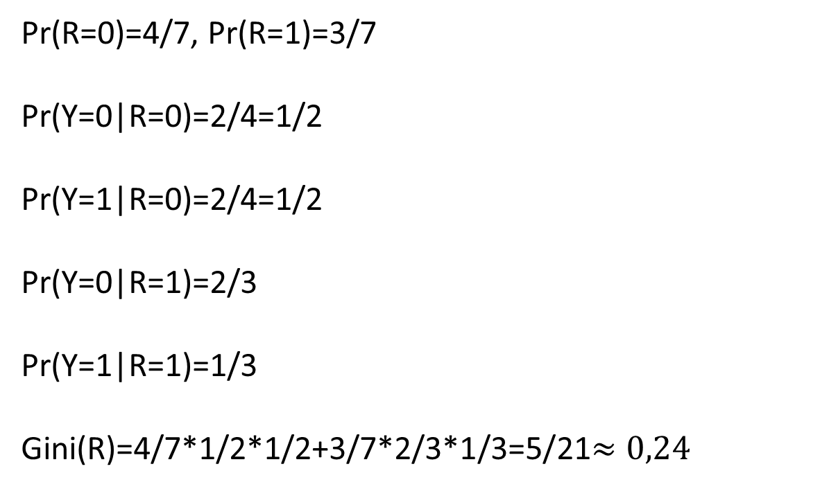
The GINI uncertainty for feature R
Match number | V | D | L | R | Victory Y
1 | 1 | 1 | 1 | 1 | 0
2 | 1 | 1 | 1 | 0 | 1
3 | 1 | 1 | 0 | 0 | 0
4 | 0 | 1 | 0 | 0 | 1
5 | 0 | 0 | 0 | 0 | 0
6 | 0 | 1 | 0 | 1 | 1
7 | 1 | 0 | 1 | 1 | 0
Pr(R=0)=4/7, Pr(R=1)=3/7
Pr(Y=0|R=0)=2/4=1/2
Pr(Y=1|R=0)=2/4=1/2
Pr(Y=0|R=1)=2/3
Pr(Y=1|R=1)=1/3
Gini(R)=4/7*1/2*1/2+3/7*2/3*1/3=5/21$≈0,24$
Notes:
Moore observed that the number of transistors that could be
put on a single chip was doubling every year, and correctly predicted that this pace
would continue into the near future.
3. The computer becomes smaller, making it more convenient to place in a variety of environments.
4. There is a reduction in power requirements.
5. The interconnections on the integrated circuit are much more reliable than
solder connections. With more circuitry on each chip, there are fewer interchip connections.

Slide 16
WE FIND THE SIGN WITH THE MINIMUM GINI
Gini(V)=0.22
Gini(D)=0.17 (!)
Gini(L)=0.24
Gini(R)=0.24
This attribute goes to the top of the tree.
The training sample is divided into 2 parts.
Notes:
Pentium III: The Pentium III incorporates additional floating- point instructions: The Streaming SIMD Extensions (SSE) instruction set extension added 70 new instructions
Core: This is the first Intel x86 microprocessor with a dual core, referring to the implementation of two cores on a single chip
Core 2: The Core 2 extends the Core architecture to 64 bits.
Core i9 :
Core i9 is a family of high-performance and high core count 64-bit x86 microprocessors introduced by Intel in mid-2017

Slide 17
We find the sign with the minimal Gini
D
1
0
Match number | V | L | R | Y
1 | 1 | 1 | 1 | 0
2 | 1 | 1 | 0 | 1
3 | 1 | 0 | 0 | 0
4 | 0 | 0 | 0 | 1
6 | 0 | 0 | 1 | 1
Match number | V | L | R | Y
5 | 0 | 0 | 0 | 0
7 | 1 | 1 | 1 | 0
In this worksheet all objects belong to the same class (Y=0).
This is where the branches end.
Notes:
Pentium III: The Pentium III incorporates additional floating- point instructions: The Streaming SIMD Extensions (SSE) instruction set extension added 70 new instructions
Core: This is the first Intel x86 microprocessor with a dual core, referring to the implementation of two cores on a single chip
Core 2: The Core 2 extends the Core architecture to 64 bits.
Core i9 :
Core i9 is a family of high-performance and high core count 64-bit x86 microprocessors introduced by Intel in mid-2017

Slide 18
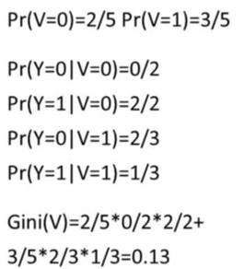
Working with objects from the left vertex
Match number | V | L | R | Y
1 | 1 | 1 | 1 | 0
2 | 1 | 1 | 0 | 1
3 | 1 | 0 | 0 | 0
4 | 0 | 0 | 0 | 1
6 | 0 | 0 | 1 | 1
Notes:
Pentium III: The Pentium III incorporates additional floating- point instructions: The Streaming SIMD Extensions (SSE) instruction set extension added 70 new instructions
Core: This is the first Intel x86 microprocessor with a dual core, referring to the implementation of two cores on a single chip
Core 2: The Core 2 extends the Core architecture to 64 bits.
Core i9 :
Core i9 is a family of high-performance and high core count 64-bit x86 microprocessors introduced by Intel in mid-2017

Slide 19
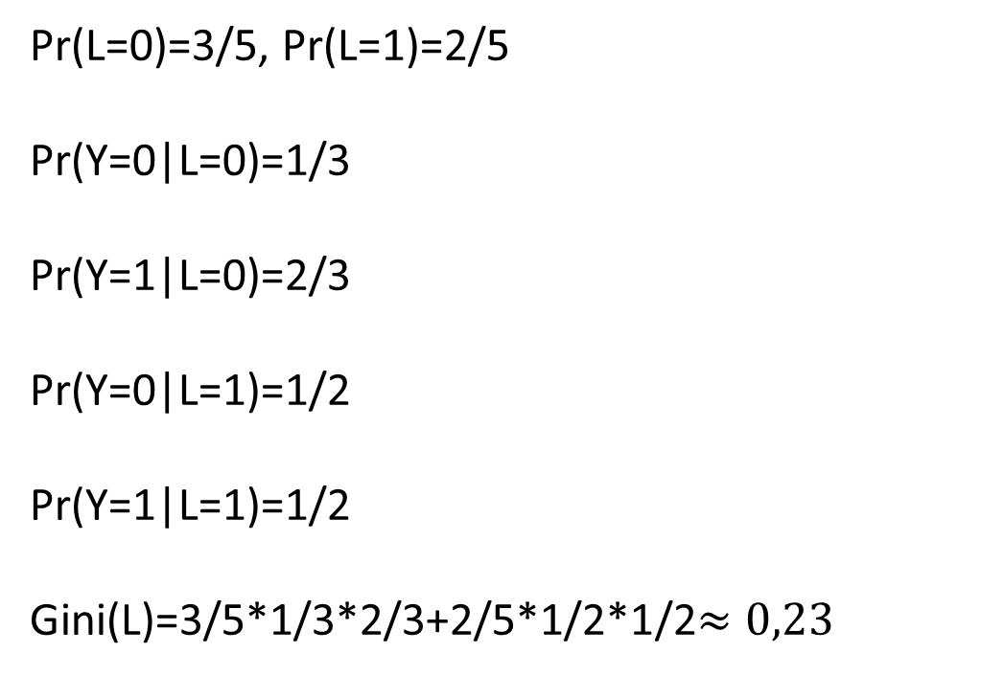
Working with objects from the left vertex
Pr(L=0)=3/5, Pr(L=1)=2/5
Pr(Y=0|L=0)=1/3
Pr(Y=1|L=0)=2/3
Pr(Y=0|L=1)=1/2
Pr(Y=1|L=1)=1/2
Gini(L)=3/5*1/3*2/3+2/5*1/2*1/2$≈0,23$
Match number | V | L | R | Y
1 | 1 | 1 | 1 | 0
2 | 1 | 1 | 0 | 1
3 | 1 | 0 | 0 | 0
4 | 0 | 0 | 0 | 1
6 | 0 | 0 | 1 | 1
Notes:
Pentium III: The Pentium III incorporates additional floating- point instructions: The Streaming SIMD Extensions (SSE) instruction set extension added 70 new instructions
Core: This is the first Intel x86 microprocessor with a dual core, referring to the implementation of two cores on a single chip
Core 2: The Core 2 extends the Core architecture to 64 bits.
Core i9 :
Core i9 is a family of high-performance and high core count 64-bit x86 microprocessors introduced by Intel in mid-2017

Slide 20
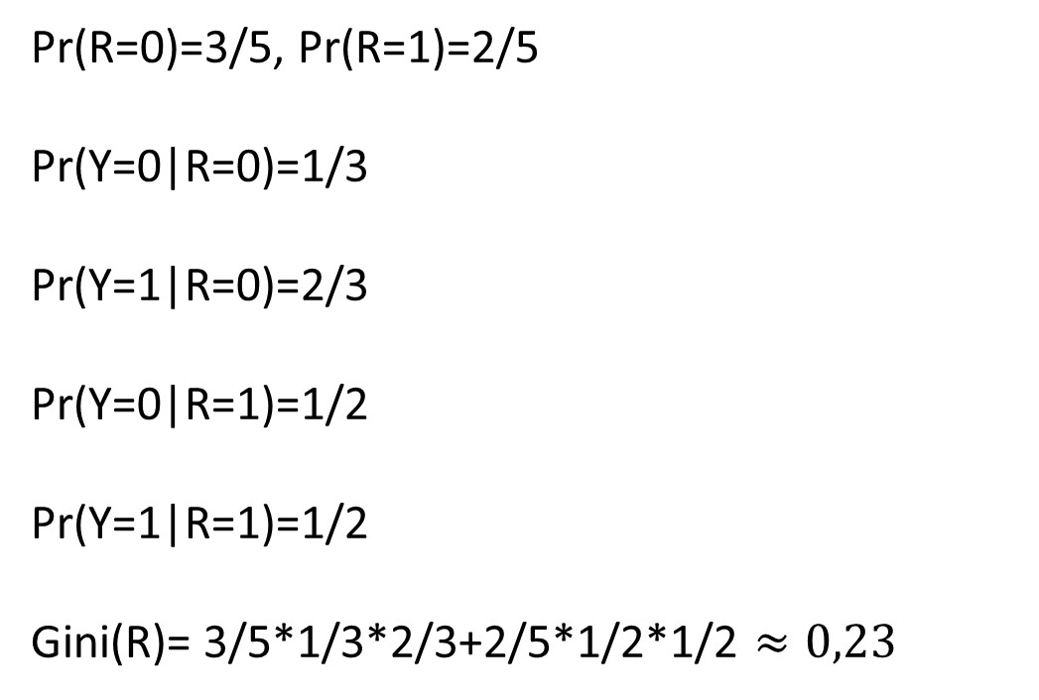
Working with objects from the left vertex
Pr(R=0)=3/5, Pr(R=1)=2/5
Pr(Y=0|R=0)=1/3
Pr(Y=1|R=0)=2/3
Pr(Y=0|R=1)=1/2
Pr(Y=1|R=1)=1/2
Gini(R)= 3/5*1/3*2/3+2/5*1/2*1/2 $≈0,23$
Match number | V | L | R | Y
1 | 1 | 1 | 1 | 0
2 | 1 | 1 | 0 | 1
3 | 1 | 0 | 0 | 0
4 | 0 | 0 | 0 | 1
6 | 0 | 0 | 1 | 1
Notes:
Pentium III: The Pentium III incorporates additional floating- point instructions: The Streaming SIMD Extensions (SSE) instruction set extension added 70 new instructions
Core: This is the first Intel x86 microprocessor with a dual core, referring to the implementation of two cores on a single chip
Core 2: The Core 2 extends the Core architecture to 64 bits.
Core i9 :
Core i9 is a family of high-performance and high core count 64-bit x86 microprocessors introduced by Intel in mid-2017

Slide 21
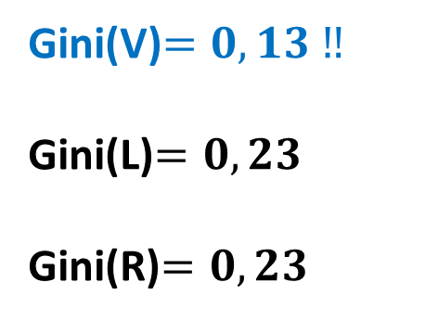
Working with objects from the left vertex
Match number | V | L | R | Y
1 | 1 | 1 | 1 | 0
2 | 1 | 1 | 0 | 1
3 | 1 | 0 | 0 | 0
4 | 0 | 0 | 0 | 1
6 | 0 | 0 | 1 | 1
Gini(V)$=0,13 ‼$
Gini(L)$=0,23$
Gini(R)$=0,23$
Notes:
Pentium III: The Pentium III incorporates additional floating- point instructions: The Streaming SIMD Extensions (SSE) instruction set extension added 70 new instructions
Core: This is the first Intel x86 microprocessor with a dual core, referring to the implementation of two cores on a single chip
Core 2: The Core 2 extends the Core architecture to 64 bits.
Core i9 :
Core i9 is a family of high-performance and high core count 64-bit x86 microprocessors introduced by Intel in mid-2017

Slide 22
Working with objects from the left vertex
D
1
0
V
Y=0
1
0
Match number | L | R | Y
1 | 1 | 1 | 0
2 | 1 | 0 | 1
3 | 0 | 0 | 0
Match number | L | R | Y
4 | 0 | 0 | 1
6 | 0 | 1 | 1
In this worksheet all objects belong to
the same class (Y=1).
This is where the branches end.
We will build a branch here
Notes:
Pentium III: The Pentium III incorporates additional floating- point instructions: The Streaming SIMD Extensions (SSE) instruction set extension added 70 new instructions
Core: This is the first Intel x86 microprocessor with a dual core, referring to the implementation of two cores on a single chip
Core 2: The Core 2 extends the Core architecture to 64 bits.
Core i9 :
Core i9 is a family of high-performance and high core count 64-bit x86 microprocessors introduced by Intel in mid-2017

Slide 23
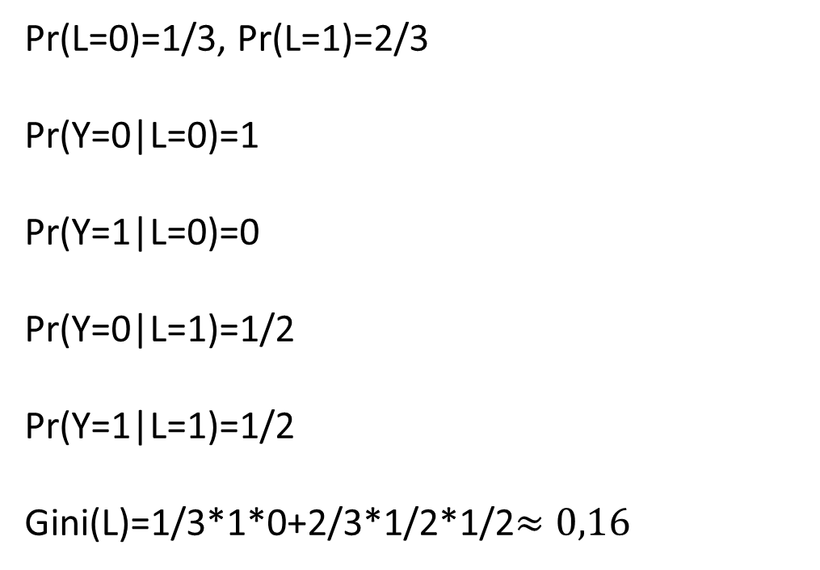
Now we are working with objects from the left vertex
Here we get:
Pr(L=0)=1/3, Pr(L=1)=2/3
Pr(Y=0|L=0)=1
Pr(Y=1|L=0)=0
Pr(Y=0|L=1)=1/2
Pr(Y=1|L=1)=1/2
Gini(L)=1/3*1*0+2/3*1/2*1/2$≈0,16$
Match number | L | R | Y
1 | 1 | 1 | 0
2 | 1 | 0 | 1
3 | 0 | 0 | 0
Notes:
Pentium III: The Pentium III incorporates additional floating- point instructions: The Streaming SIMD Extensions (SSE) instruction set extension added 70 new instructions
Core: This is the first Intel x86 microprocessor with a dual core, referring to the implementation of two cores on a single chip
Core 2: The Core 2 extends the Core architecture to 64 bits.
Core i9 :
Core i9 is a family of high-performance and high core count 64-bit x86 microprocessors introduced by Intel in mid-2017

Slide 24
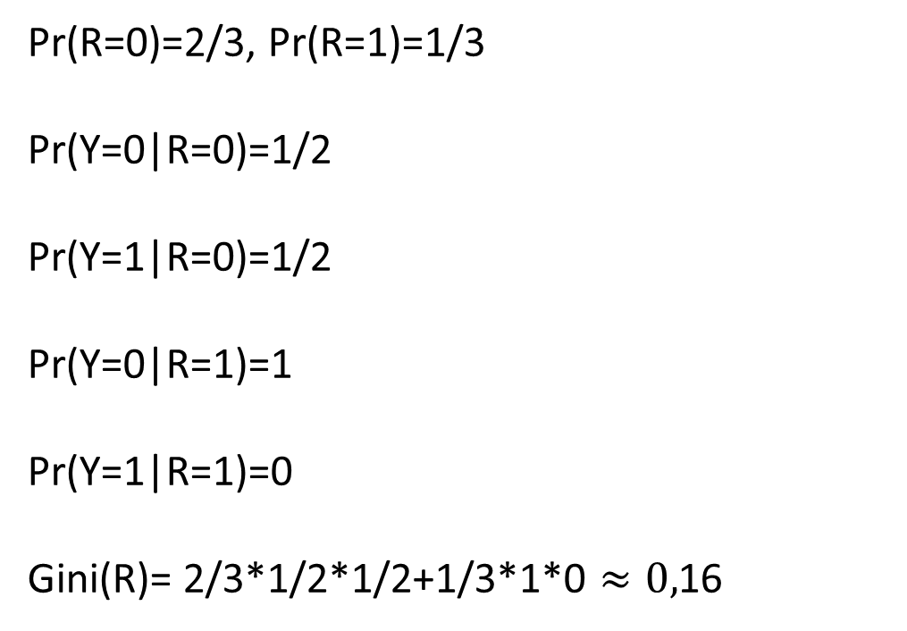
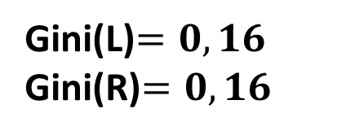
Now we are working with objects from the left vertex
Here we get:
Pr(R=0)=2/3, Pr(R=1)=1/3
Pr(Y=0|R=0)=1/2
Pr(Y=1|R=0)=1/2
Pr(Y=0|R=1)=1
Pr(Y=1|R=1)=0
Gini(R)= 2/3*1/2*1/2+1/3*1*0 $≈0,$16
Match number | L | R | Y
1 | 1 | 1 | 0
2 | 1 | 0 | 1
3 | 0 | 0 | 0
Gini(L)$=0,16$
Gini(R)$=0,16$
You can choose any one of the signs
Notes:
Pentium III: The Pentium III incorporates additional floating- point instructions: The Streaming SIMD Extensions (SSE) instruction set extension added 70 new instructions
Core: This is the first Intel x86 microprocessor with a dual core, referring to the implementation of two cores on a single chip
Core 2: The Core 2 extends the Core architecture to 64 bits.
Core i9 :
Core i9 is a family of high-performance and high core count 64-bit x86 microprocessors introduced by Intel in mid-2017

Slide 25
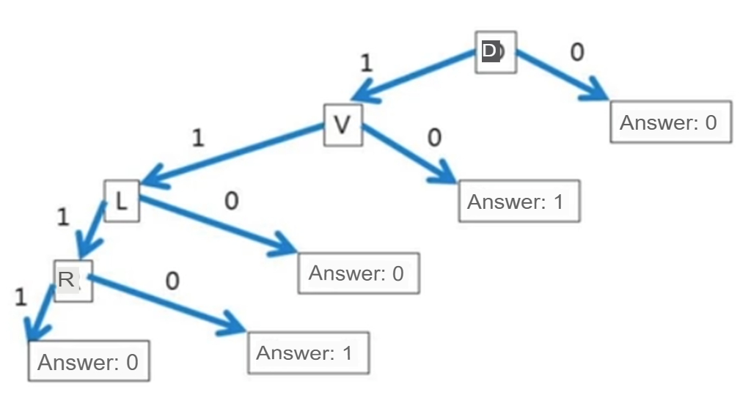
We got a tree
Notes:
Pentium III: The Pentium III incorporates additional floating- point instructions: The Streaming SIMD Extensions (SSE) instruction set extension added 70 new instructions
Core: This is the first Intel x86 microprocessor with a dual core, referring to the implementation of two cores on a single chip
Core 2: The Core 2 extends the Core architecture to 64 bits.
Core i9 :
Core i9 is a family of high-performance and high core count 64-bit x86 microprocessors introduced by Intel in mid-2017

Slide 26
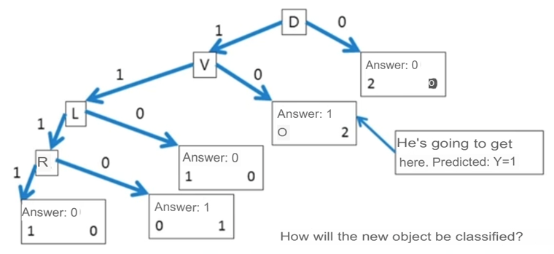
Match number | V | D | L | R | Victory Y
1 | 0 | 1 | 1 | 0 | ?
Notes:
A microcontroller chip makes a substantially different use of the logic space available. Microcontrollers are heavily utilized in automation processes.
Another typical feature of a microcontroller is that it does not provide for human interaction. The microcontroller is programmed for a specific task, embedded in its device, and executes as and when required.
A microcontroller is a single chip that contains the processor,
non-volatile memory for the program (ROM), volatile memory for input and output
(RAM), a clock, and an I/O control unit
The processor portion of the microcontroller has a much lower silicon area than other microprocessors and much higher energy efficiency.

Slide 27
Key Terms
tree predict branching impurity | feature division entropy subset set | logical predicate minimum Gini GINI uncertainty statistical informativeness decision trees
Notes:
Today we have studied the following concepts
In the next lecture, we will repeat these concepts. You should explain their meaning in a few words. Everyone understands this ?
Until the next lecture

